Slide 1
TREES

Slide 2
Topic Covered
Basic Trees concepts and terminology
Memory Representation of tree
Binary Trees
Traversing Binary trees
Complete and extended binary tree
General Trees

Slide 3
Non-linear List
A non linear list in data structure is a special type of list having one or more successor
Non-linear list divided into two categories
Non Linear list
Tree
Graph
Two Way Tree
Multi Way Tree

Slide 4
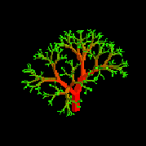
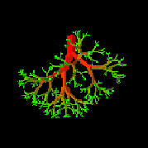
Tree
A tree is a finite nonempty set of elements.
It is an abstract model of a hierarchical structure.
Trees are used extensively in computer science to represent algebraic formula, an efficient method for searching large , dynamic list and in file system
leaves
branches
root
Nature View of a Tree
Computer Scientist’s View

Slide 5
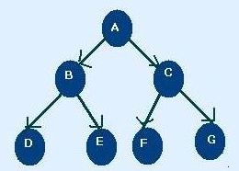
Tree Terminology
Node : each of the elements or data that constructs tree. i.e. A, B, C, D, E, F
Edges: Finite set of directed lines that connects node
Root: The first Node of tree(If tree is not empty) i.e. A
In Degree : The number of edges comes into particular node
Node | In Degree
A | 0
B | 1
C | 1
D | 1
E | 1
F | 1
G | 1

Slide 6
Tree Terminology
Out Degree : The number of edges comes out particular node
Node | Out Degree
A | 2
B | 2
C | 2
D | 0
E | 0
F | 0
G | 0

Slide 7
Tree Terminology
Total Degree : Summation of Indegree and outdegree
N.B: Each node except root node of tree must have an indegree of 1
Node | Indegree | outdegree | degree
A | 0 | 2 | 2
B | 1 | 2 | 3
C | 1 | 2 | 3
D | 1 | 0 | 1
E | 1 | 0 | 1
F | 1 | 0 | 1
G | 1 | 0 | 1

Slide 8
Tree Terminology
Leaf : Nodes that have outdegree 0 i.e. no successor. i.e. D, E,F,G
Internal Node : A node that is not root or leaf node. It is found in middle portion of tree i.e. B,C
Parent Node: Nodes that have outdegree greater than 0 i.e. it has successor node i.e. A, B, C
Child Node: Nodes that have indegree 1 i.e. one predecessor
i.e. B, C, D, E, F, G, H
Sibling : Nodes having same parent i.e. B,C are sibling and D, E and F,G are sibling
Path: A sequence of connected node from one node to another. i.e. path from root to D is ABD, path from C to G is CG
Ancestor of a Node : Any node in the path from root to that node. i.e. Ancestor of D is A,B
Descendent of a Node : All node in the path from that node to the leaf node. i.e. Descendent of : B is D

Slide 9
Tree Terminology
Level/depth: level of a node is its distance from root. i.e. root has 0 distance from itself, so root is at level 0
the children of the root are at level 1 and their children are at level 2 and so on
Height : Maximum level of any node in the tree.i.e. 3
Subtrees: A tree may be divided into subtrees. The first node of the subtree is considered as root and is used to name the subtree. i.e BDE, CFG
Level 0
Level 1
Level 2
Level 3
H

Slide 10
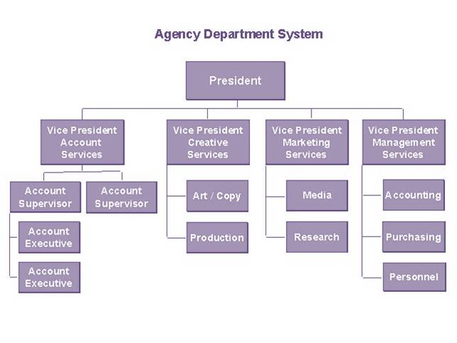
Use of tree
Tree represents a hierarchy for. e.g. the organization structure of a company.
Table of contents of a book
Unix or Windows file system

Slide 11
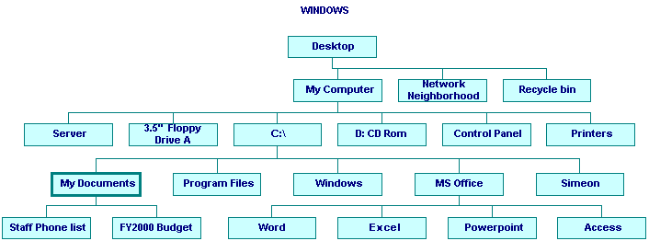
Use of tree
Unix or Windows file system

Slide 12
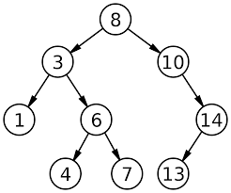
Binary trees
A binary tree is an ordered tree having at most two nodes
Node at left side of a node is called left node and at right side is called right node
No nodes can have more than two subtree
Subtrees are designed as left and right subtree.

Slide 13
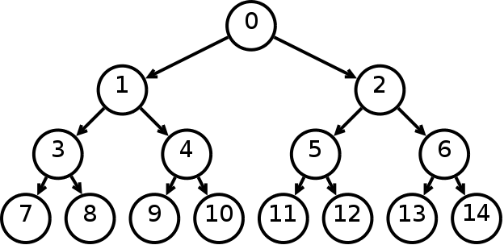
Complete Binary tree
Every nodes (except leaf) having two nodes
Maximum number of nodes in Level i is 2^{i .} i.e. nodes in level 0= 2⁰ = 1, level 1 = 2¹ = 2
In a tree of height, h
Leaf/leaves are at level h is 2^{h}
Number of nodes n,
= 2⁰ + 2¹ + 2³ +………..+ 2^{h}
=2^{h+1} -1
n = 2^{levels} -1
In a tree of node n,
The height h is : n = 2^{levels} -1
=> n+1= 2^{levels} = 2^{h+1}
=> log₂ (n+1) = h+1
=> h = log₂ (n+1) -1
L=0
L=1
L=2
L=3

Slide 14
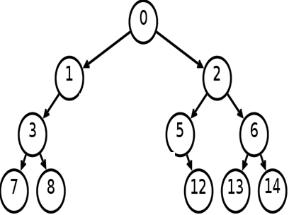
Binary tree from complete binary tree
A binary tree can be obtained from a complete binary tree by pruning

Slide 15
Minimum height of a Binary trees
A binary tree of height h has,
At most 2^{i} nodes in level I
At most 2⁰ + 2¹ + 2³ +………..+ 2^{h} = 2^{h+1} -1 nodes
If the tree has n nodes then,
n <= 2^{h+1} -1
=> h >= log₂ (n+1) -1
A binary tree has at least height of log₂ (n+1) -1 which is a complete binary tree

Slide 16
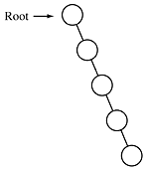
Maximum height of a Binary trees
If the tree has n nodes then the height is n-1
This is obtained when every node has exactly one child (except leaf node)

Slide 17
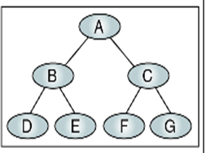
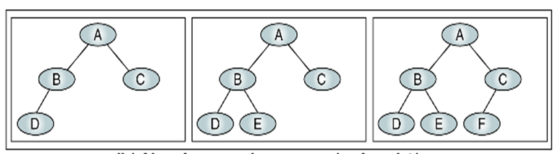
Near Complete Binary Tree
If a tree has the minimum height for its nodes and all nodes in the last level are found on the left is called near complete binary tree.

Slide 18
Binary Tree Traversal
Each Node of the tree must be processed once and only once in a predetermined sequence
Two general approach-
Depth First traversal
Breadth first traversal
Depth First traversal, the processing proceeds along a path from the root through one child to the most descendent of that first child before processing a second child
Breadth first traversal (level by level), the processing proceeds horizontally from the roots to all its children (left to right usually) i.e. A B C D E F G

Slide 19
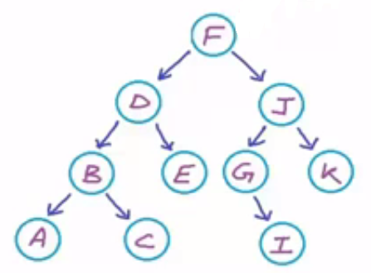
Depth First traversal
Three Standard traversal techniques :
Preorder traversal
<root > <left> <right>
Visit the root
Visit the left subtree
Visit the right subtree
i.e. F D B A C E J G I K
2. Inorder traversal
<left> <root > <right>
Visit the left subtree
Visit the root
Visit the right subtree
i.e. A B C D E F G I J K

Slide 20
Depth First traversal
Three Standard traversal techniques :
Postorder traversal
<left> <right> <root >
Visit the left subtree
Visit the right subtree
Visit the root
i.e. A C B E D I G K J F

